Slide 1
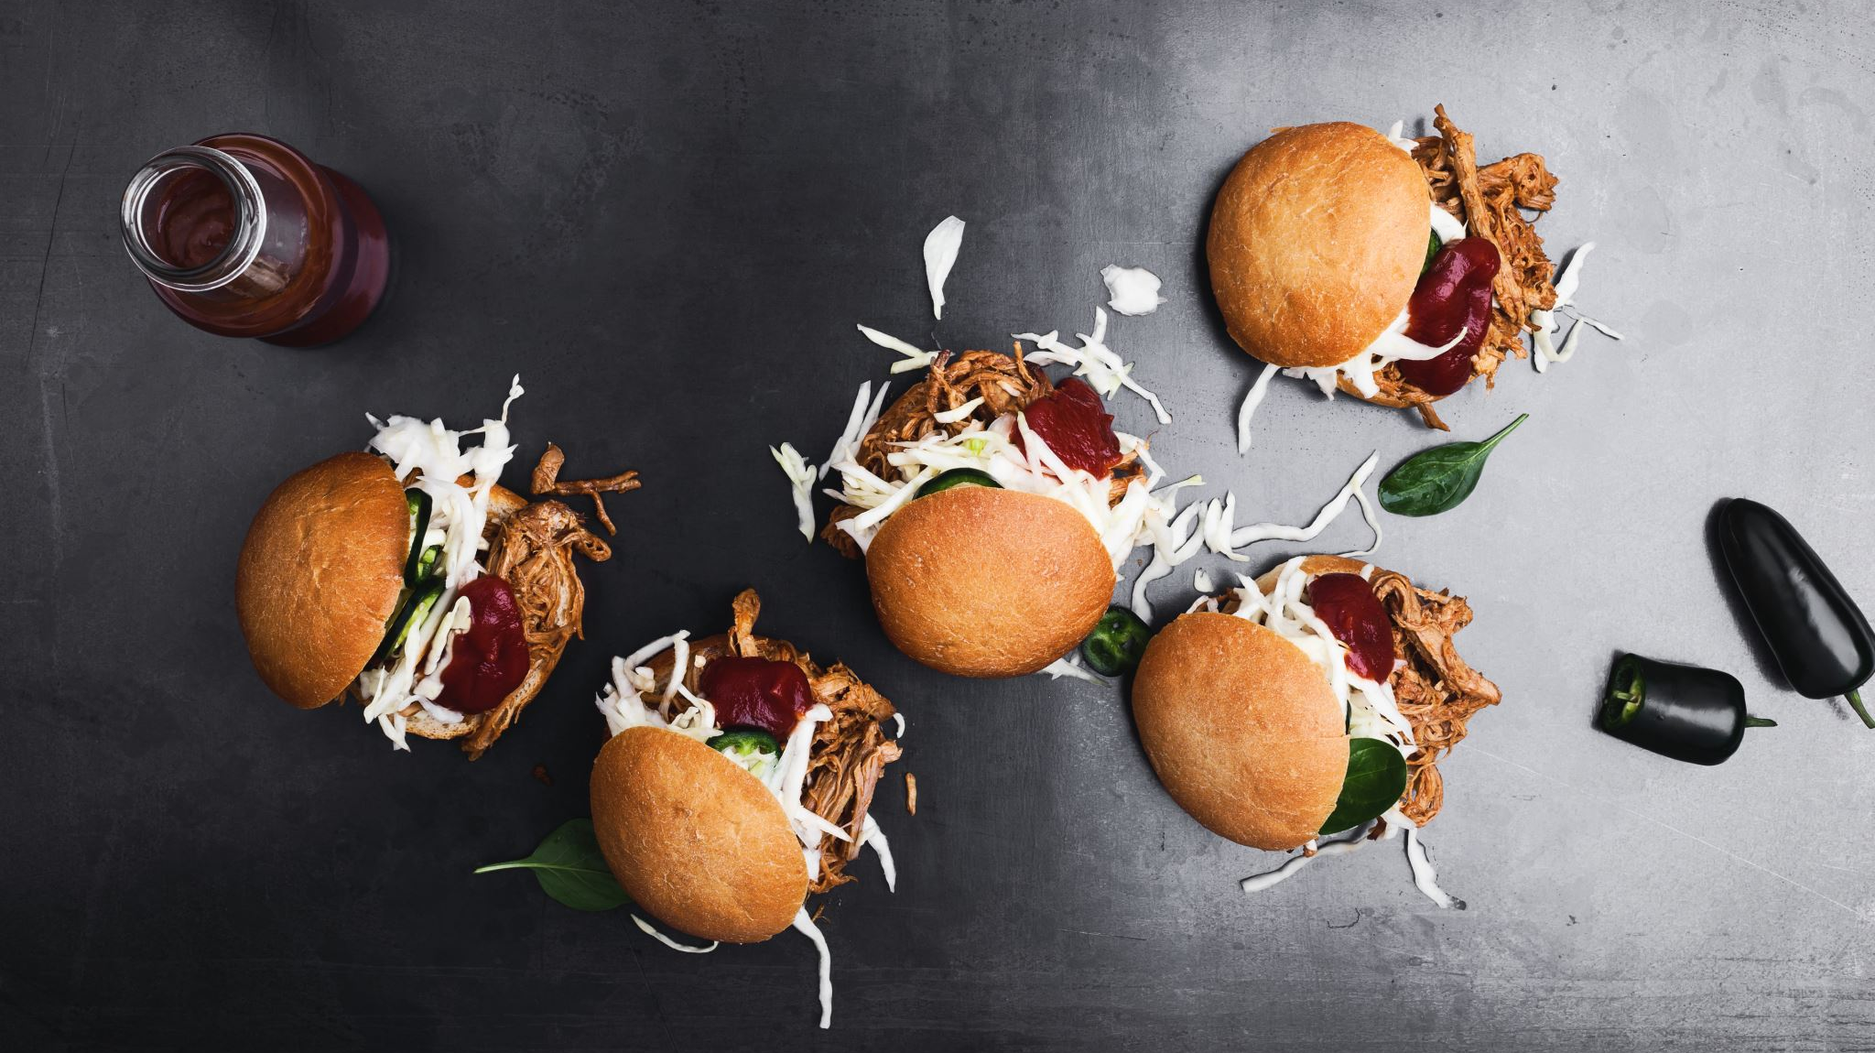
Limit Food Waste
By: Breanna Latouche

Slide 2
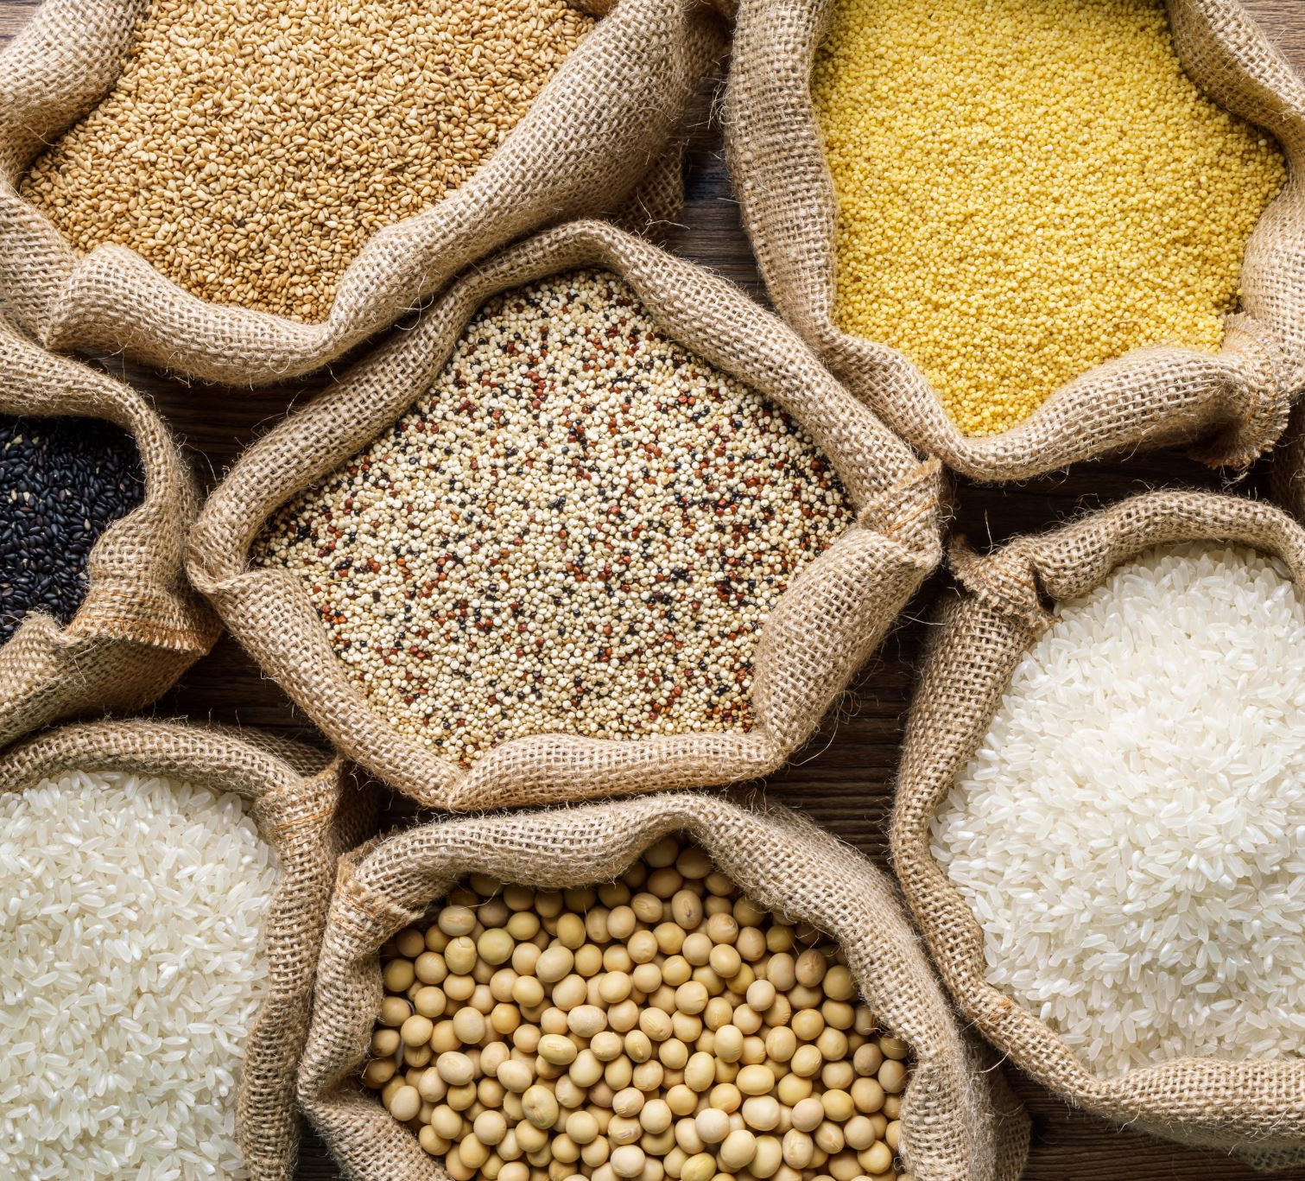
What is Food Waste?
Food that is thrown away even though it is still edible and can be used.
Food waste is prevalent in many countries and happens because of:
Inadequate distribution
Low-quality transportation of produce
Post-harvest waste
  From farmers to sellers

Slide 3
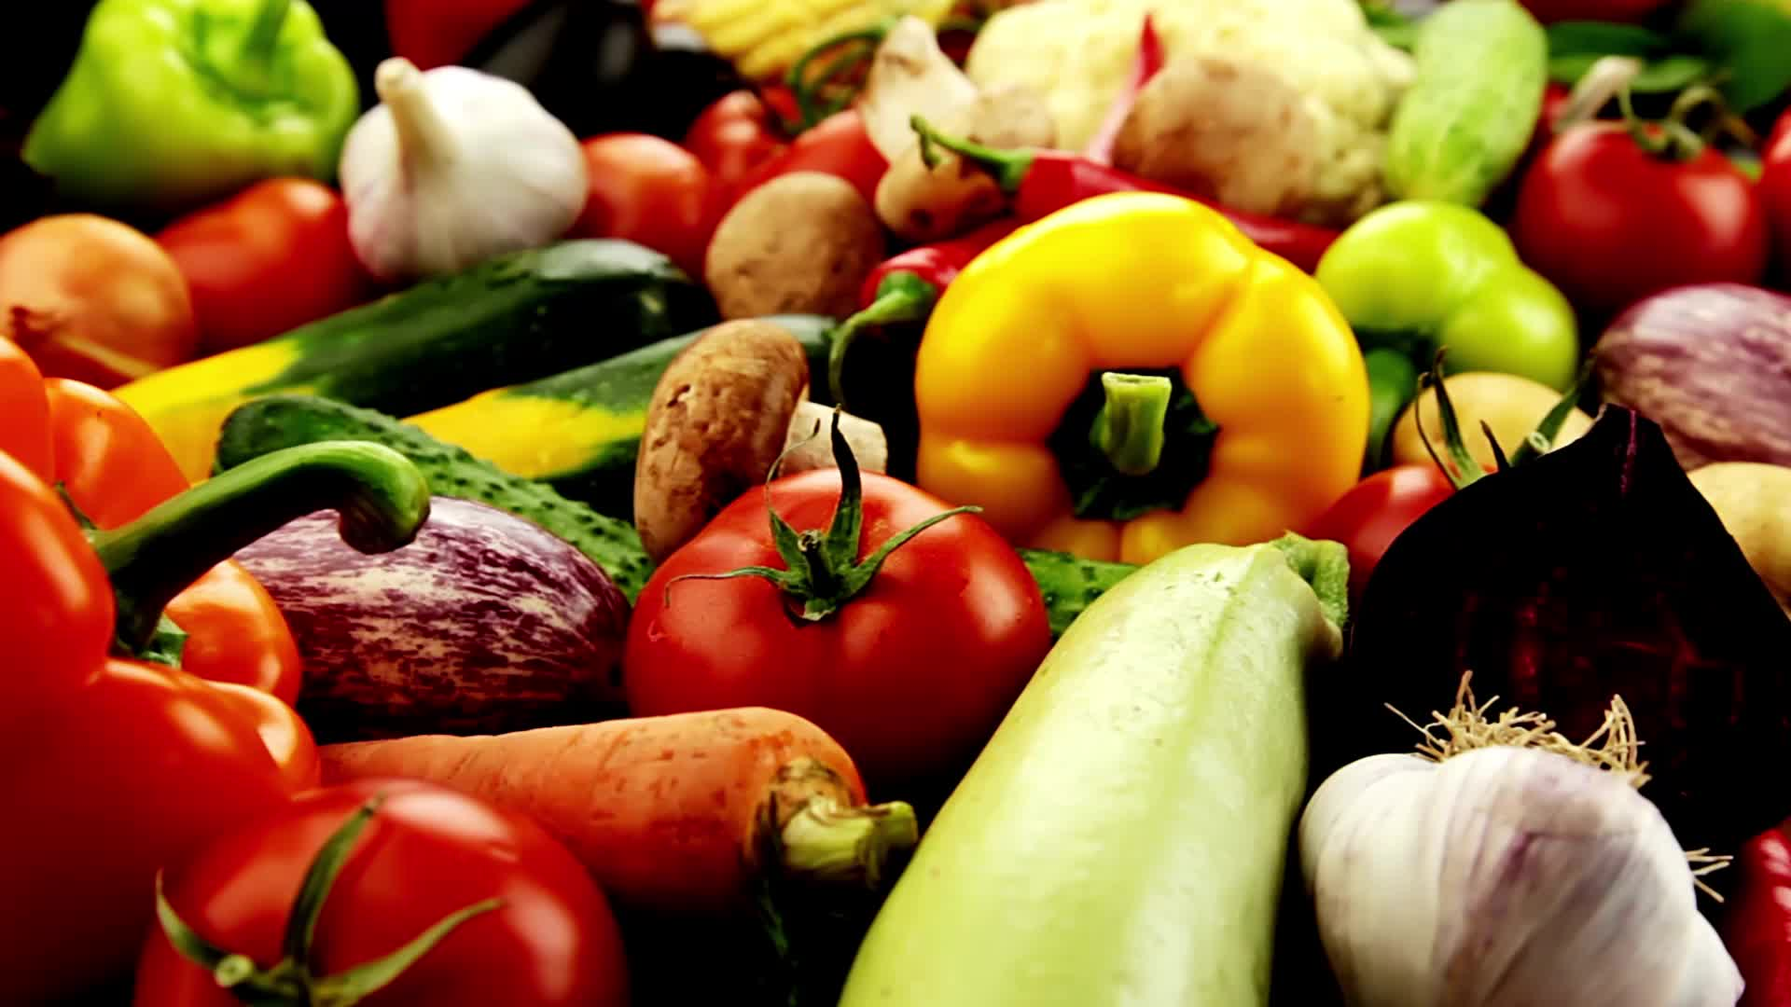
Research questions
What are local communities doing with excess food?
Where does excess food go to?
What can I do to limit food waste

Slide 4
Findings
National organizations are working to reduce food waste
USDA
United States Environmental Protection Agency
Food loss can be reduced at every stage of the supply chain
Households
Restaurants
Retailers
Food Producers
Food Distributors
Processors and Manufacturer
Governments and Policymakers

Slide 5
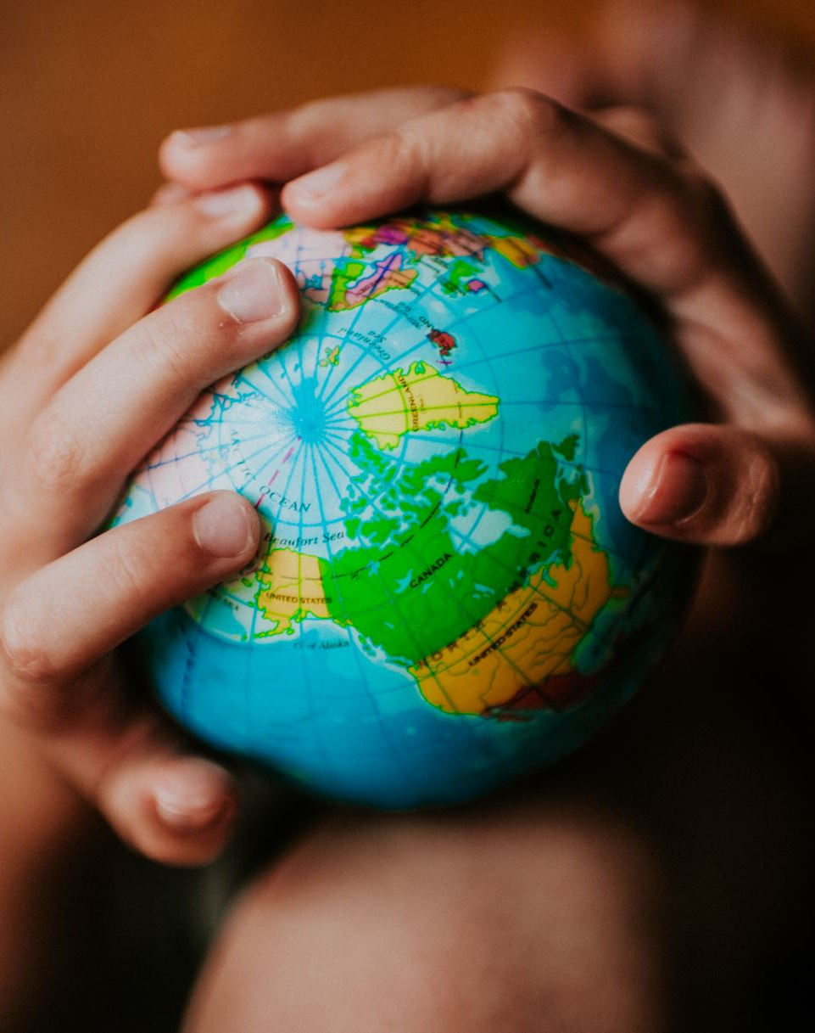
Gospel Connections
Mosiah 4:9
  9 Believe in ªGod; believe that he is, and that he ^{b}created all things, both in heaven and in earth; believe that he has all ^{c}wisdom, and all power, both in heaven and in earth; believe that man doth not ^{d}comprehend all the things which the Lord can comprehend.
  God has created all things and has a plan for each of us. Although there are a lot of struggles in the world, we can each do our part to help those in need.

Slide 6
Project Plans Steps and Resources
Volunteer at a local Foodbank
Have an interview with the Food Bank organizer
Learn how the community deals with excess food
Invite others to volunteer

Slide 7
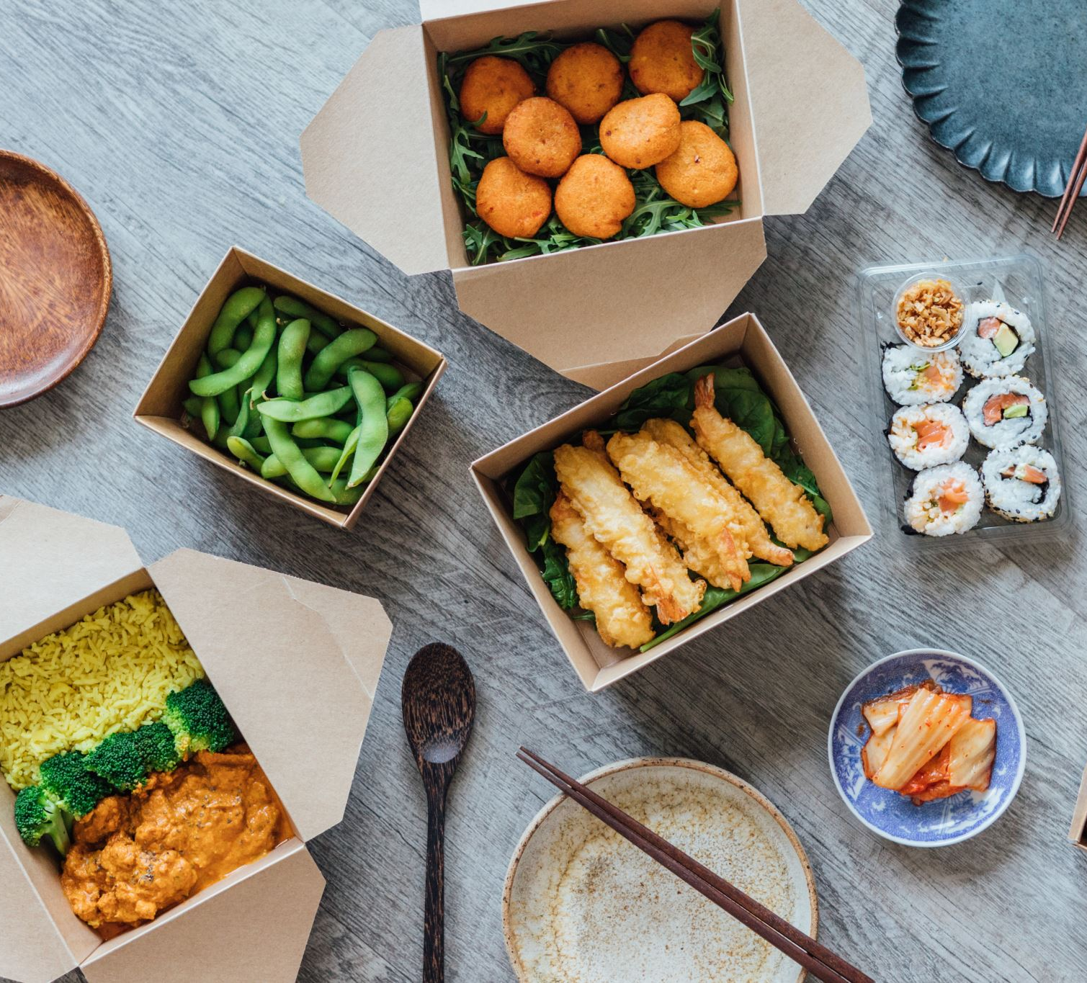
Process
1. Signed up online
2. Asked friends if they wanted to join
3. Volunteer for 1 ½ hour every Friday
4. Filled boxes and grocery bags with food
5. Clean up and break down boxes
6. Interview the Food Bank Organizer

Slide 8
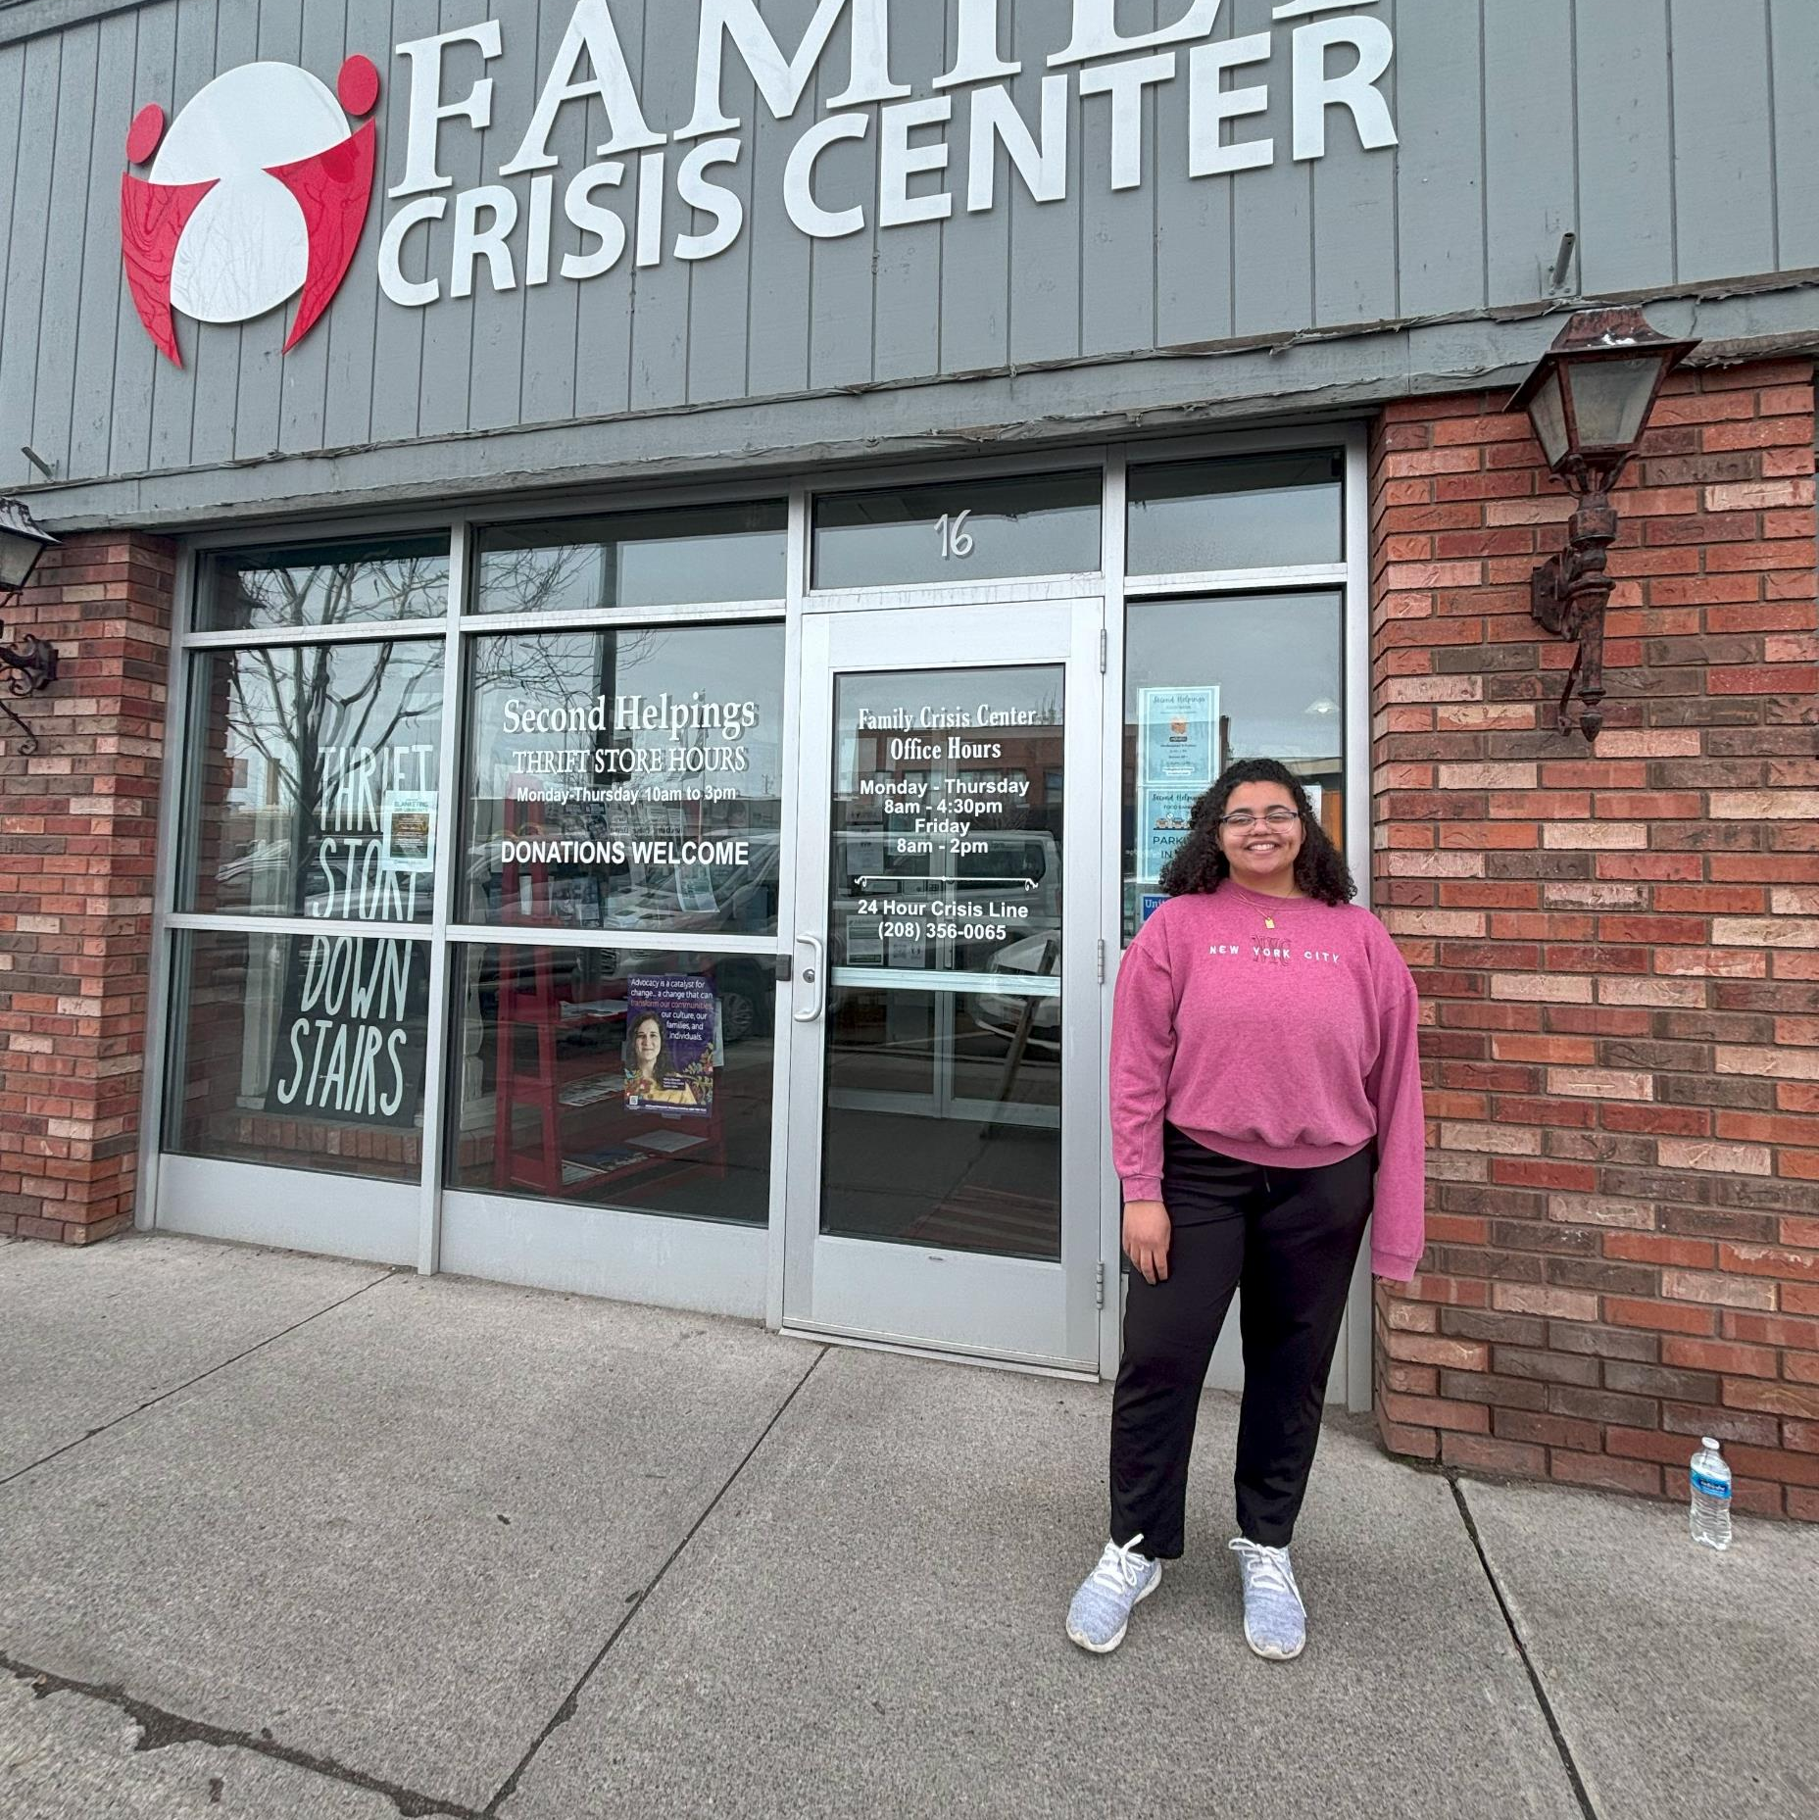
Completed Project
Volunteered at the Family Crisis Center
Every Friday for 5 weeks
Invite Friends
Had 2 friends join
Invited 2 others
Met with Food Bank organizer
Food rescue
Food from Albertsons and Walmart
Rotten food – Goes to those with farm animals
Feed 200 to 250 families
Tries to limit barriers with requirements
Works with Idaho Food Bank

Slide 9
Reflection
Did you reach your goals or feel you made an impact or improvement on the original issue?
I was able to understand the impact that organizations like the Family Crisis Center and the Idaho Food Bank do to help communities
Did you have to make any adjustments to your project?
I originally didn’t plan to volunteer at the Foodbank
Calling other grocery stores
Is there anything you would do differently next time?
I would talk to restaurants and the crossroads

Slide 10
Next Steps?
I would call restaurants and see their plans to reduce food waste
Reach out to the Idaho Food Bank
I then would ask the Family Crisis Center or Idaho Food Bank if they would teach about waste in a class setting
New Questions?
What policies are in place to reduce food waste?
Can education about food waste be taught in schools?
Future Project Ideas?
Have a representative do a presentation about food waste to a group of people
Gather a group on campus and we go volunteer at the Family Crisis Center or the Idaho Food Bank

Slide 11
References
Environmental Protection Agency. (2024, February 21). United States 2030 Food Loss and Waste Reduction Goal. EPA. https://www.epa.gov/sustainable-management-food/united-states-2030-food-loss-and-waste-reduction-goal
U.S. Department of Agriculture. (n.d.). Food Waste Activities. USDA. https://www.usda.gov/foodwaste/activities
Goodwin, L. (2023, April 20). The global benefits of reducing food loss and waste, and how to do it. World Resources Institute. https://www.wri.org/insights/reducing-food-loss-and-food-waste

