Slide 1
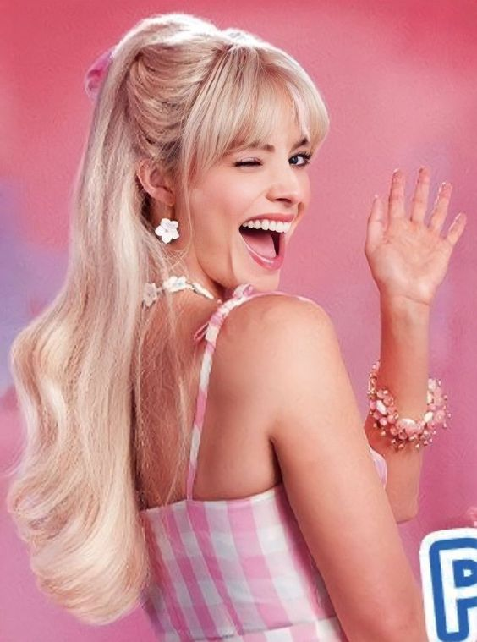
Barbie Campaign
By: Breanna Latouche & Jordyn Papa

Slide 2
"The real world is forever and irrevocably messed up."
-Barbie

Slide 3
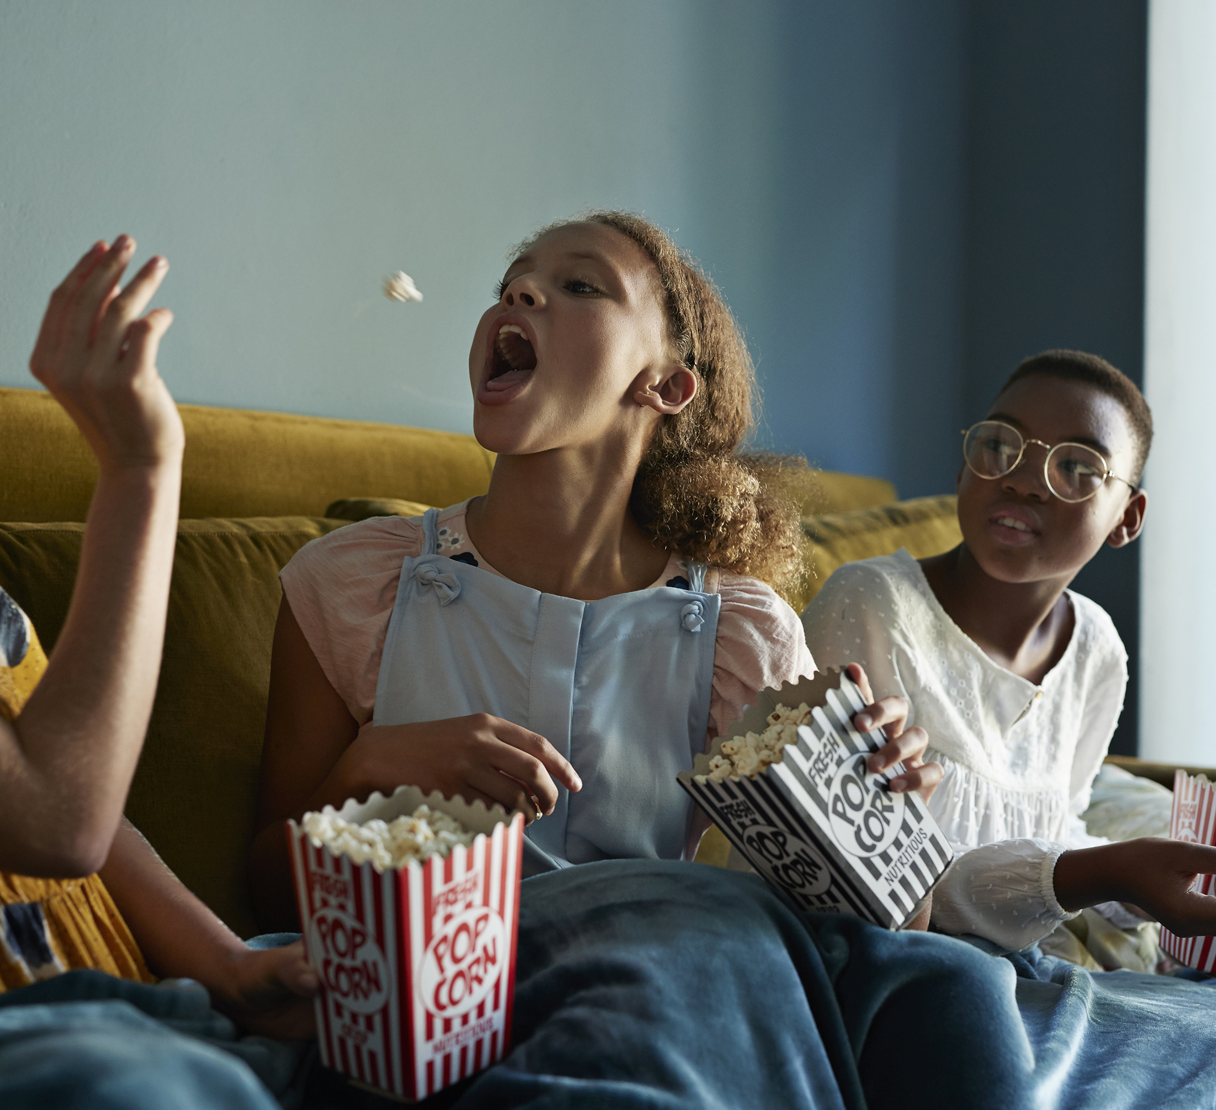
Campaign Background
Development started 2009
  Universal
The Barbies before Barbie
  Amy Schumer
  Anne Hathaway
Mattel Development 2019
  Greta Gerwig

Slide 4
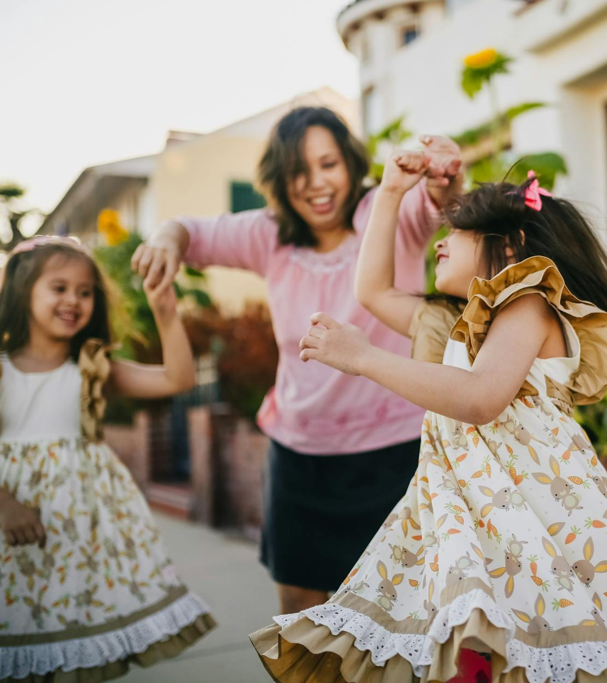
Target Audience
Women and girls
    66.2% of audience​
    74.6% under 29​
Older Audiences
  nostalgia

Slide 5
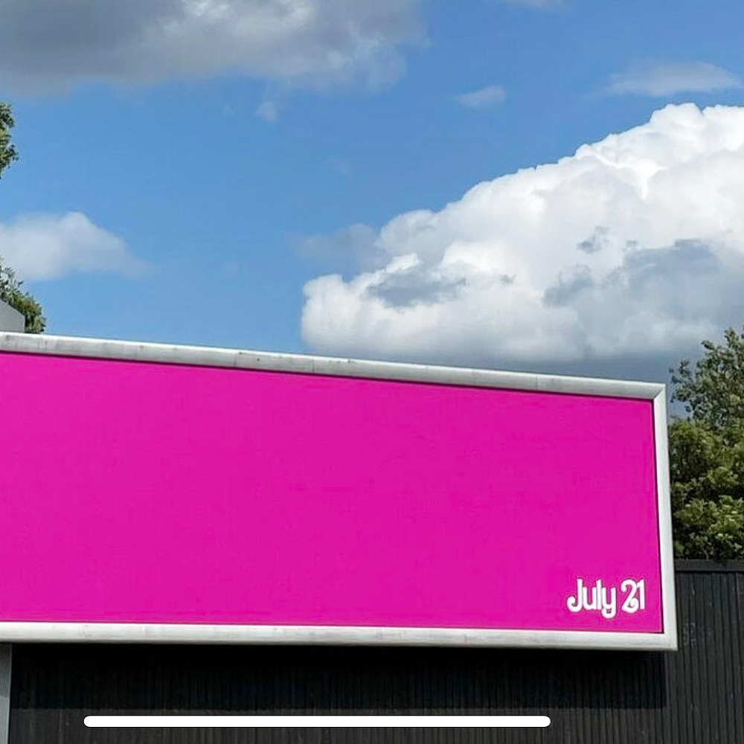
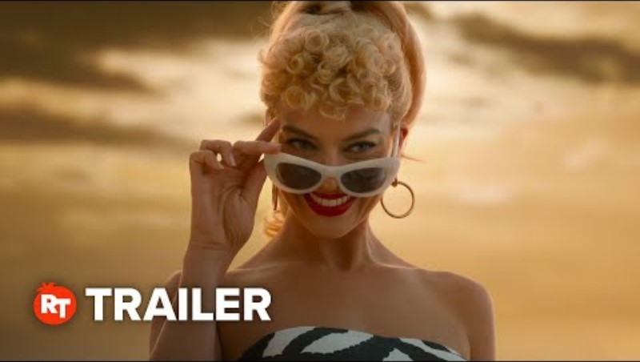
Communication Strategies
Instagram
Facebook
TikTok
YouTube Reels
Trailers

Slide 7
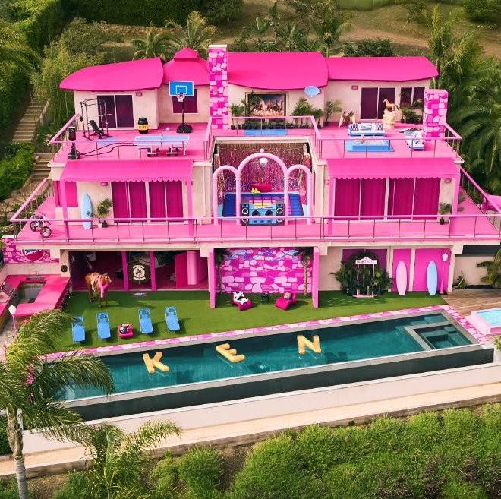
Implementation & Execution
Over 85 Collaborations
Total budget about 295 million
Earned over 1.446 billion

Slide 8
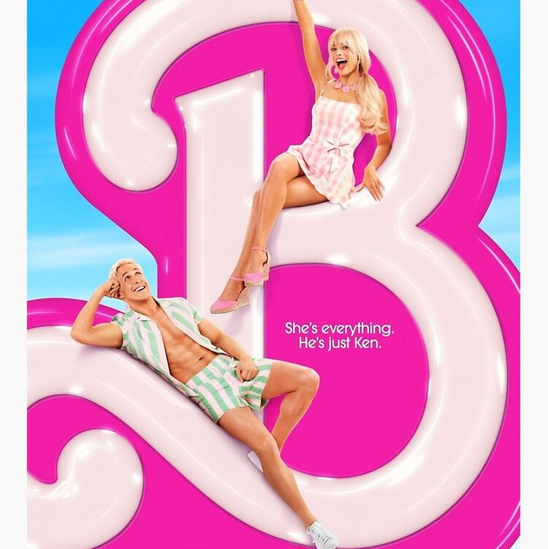
Evaluation of Success
Everyone knew about it
Widespread social media memes
An Event
Helped to change the public view
Appealed to the target audience

Slide 9
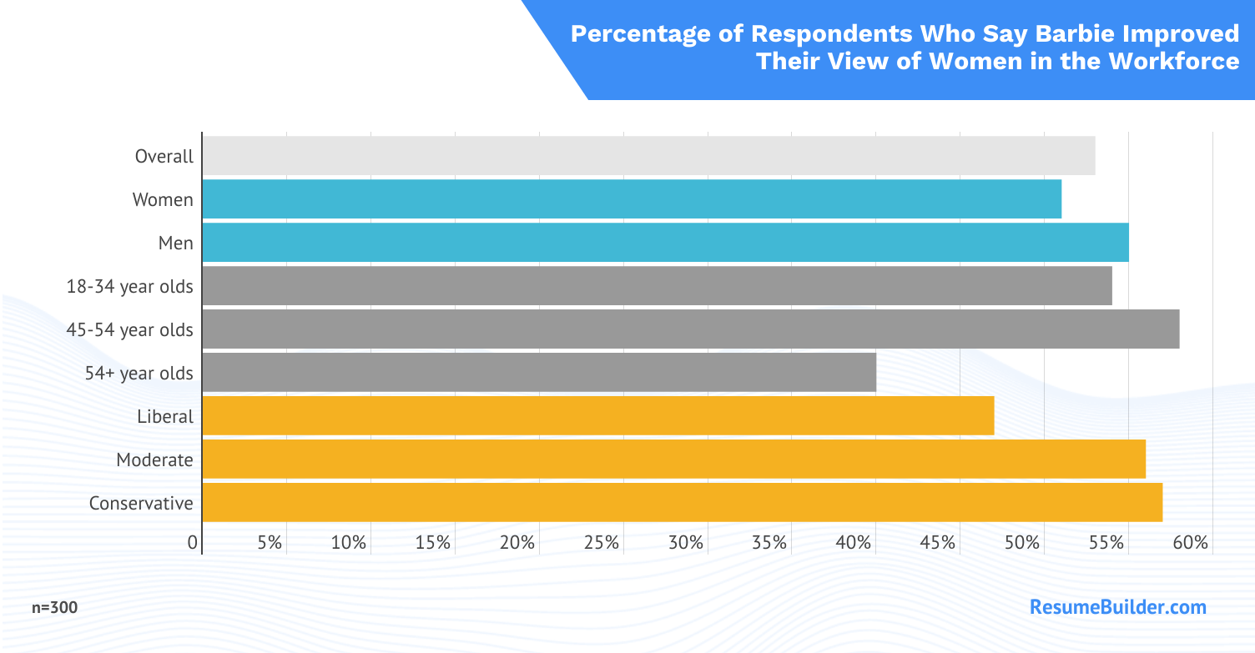

Slide 10
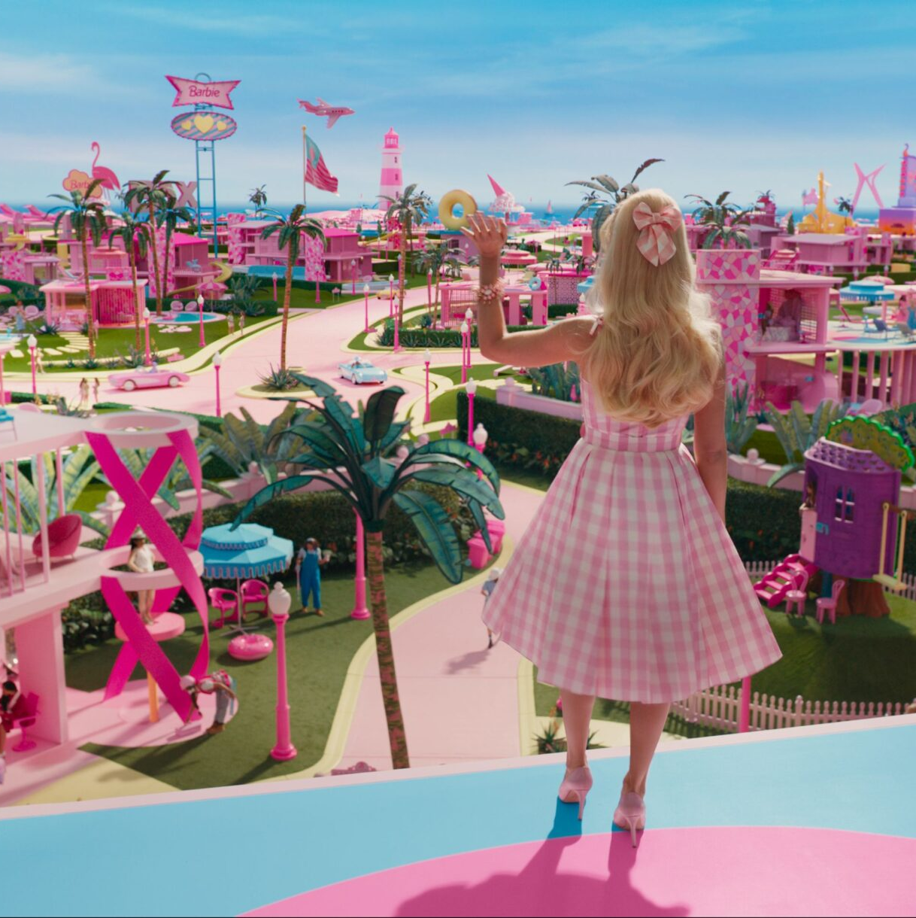
Lessons Learned
Success of Marketing
  Partnerships
  Movie premiere
Made for everyone
  PRIDE
  Love/Hate Barbie
The movie became an event
  Barbie Box
  Pink carpet
Timing
  After Covid
This Photo by Unknown Author is licensed under CC BY-SA-NC

Slide 11
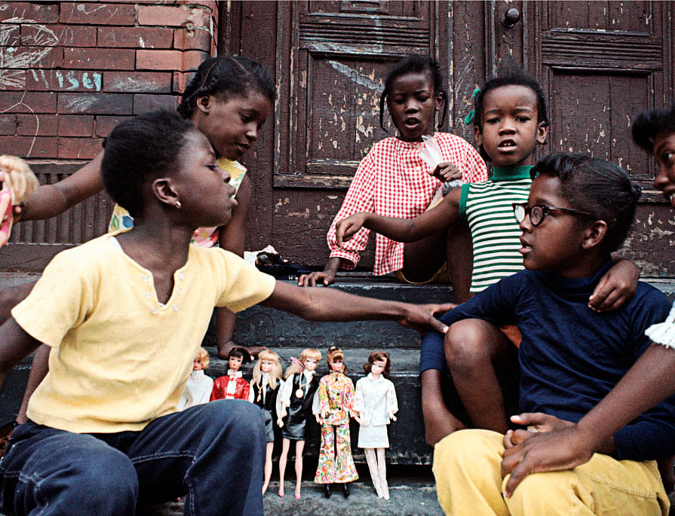
Recommendations
Use of emotion to pull at the nostalgia
Bridge gap between Barbie movie and merchandise
Appeal to the male audience
  Commercials

Slide 12
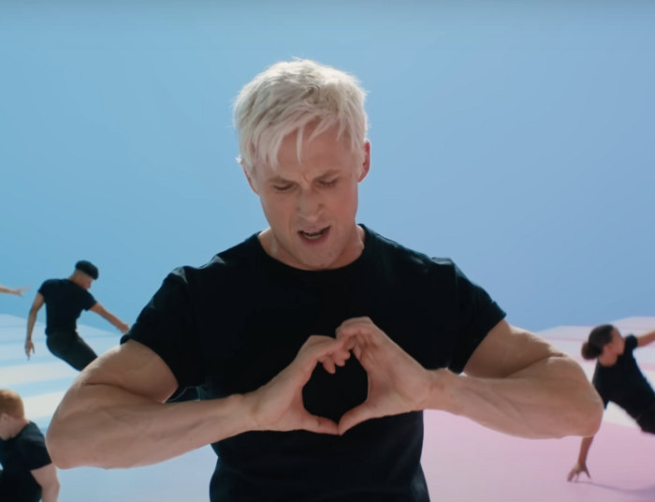
Kenough
Make its own campaign

Slide 13
Thank You

